Slide 1






NSP3-MD
Target meeting
Hadia Almahli
21st Oct 2024
Notes:
Covalent warhead
Antiviral drug for SARS cov 2
Gel based data
Picogreen assay
GSH assay
One single dose response
DABCO
SARS-CoV-2 proteins can be grouped in two major classes, structural and nonstrcutural proteins (NSPs). While structural proteins, either hold the RNA genome or are built into the viral envelope, a nonstructural protein encoded by a virus is expressed in infected cells, but not incorporated into the virion particle.

Slide 2
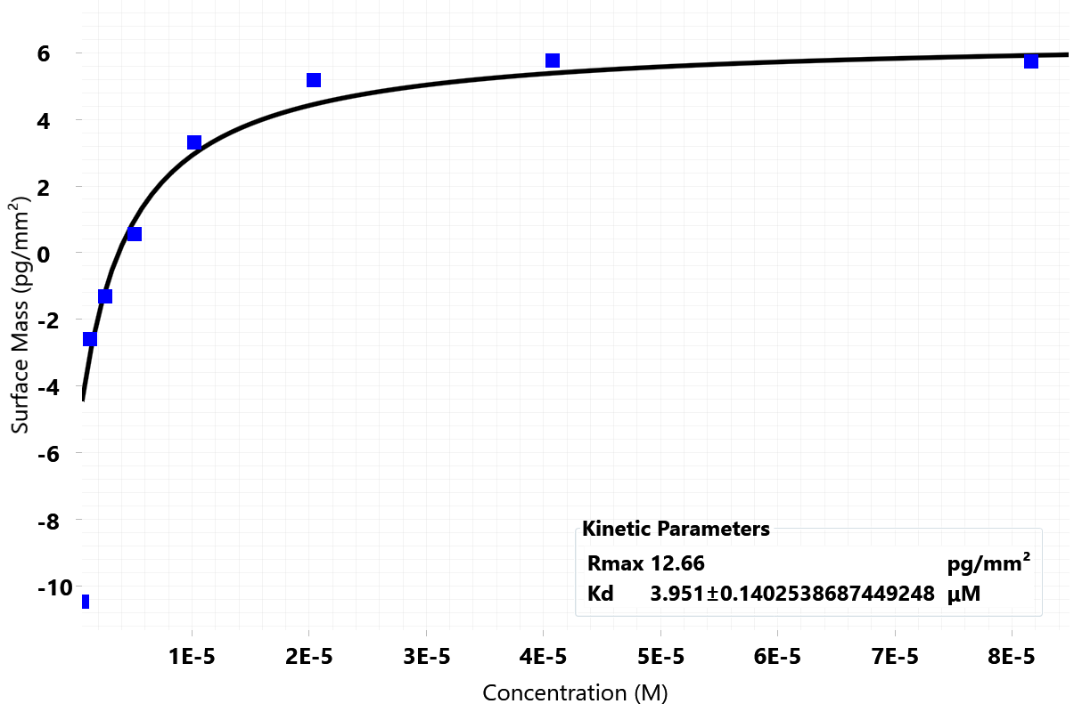
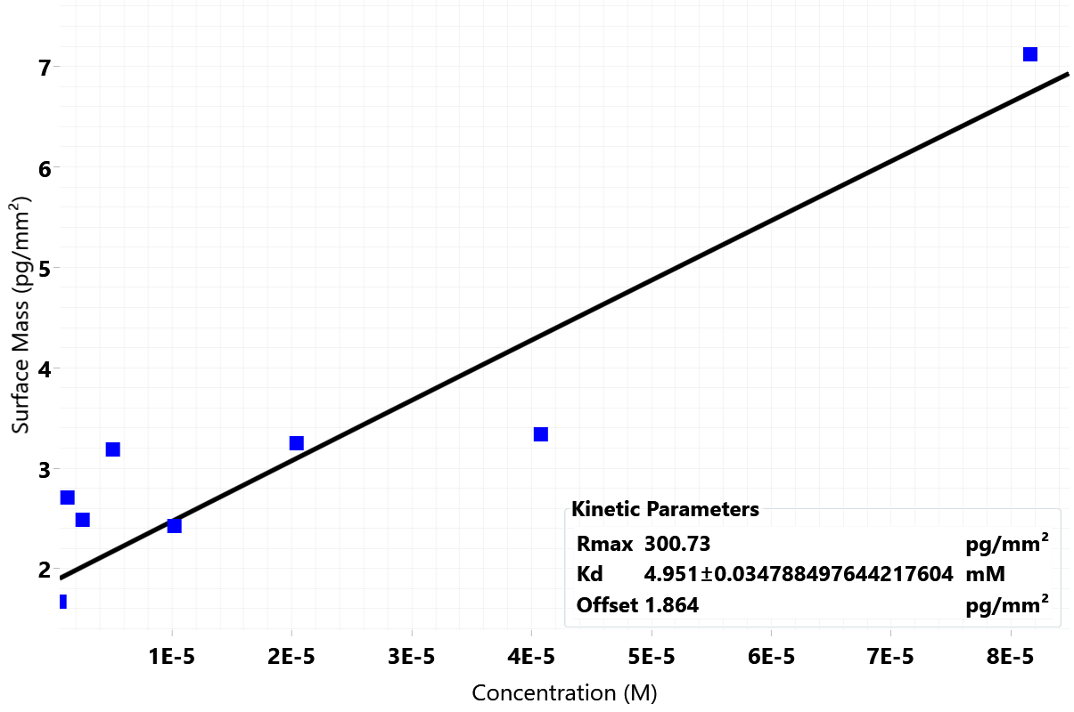
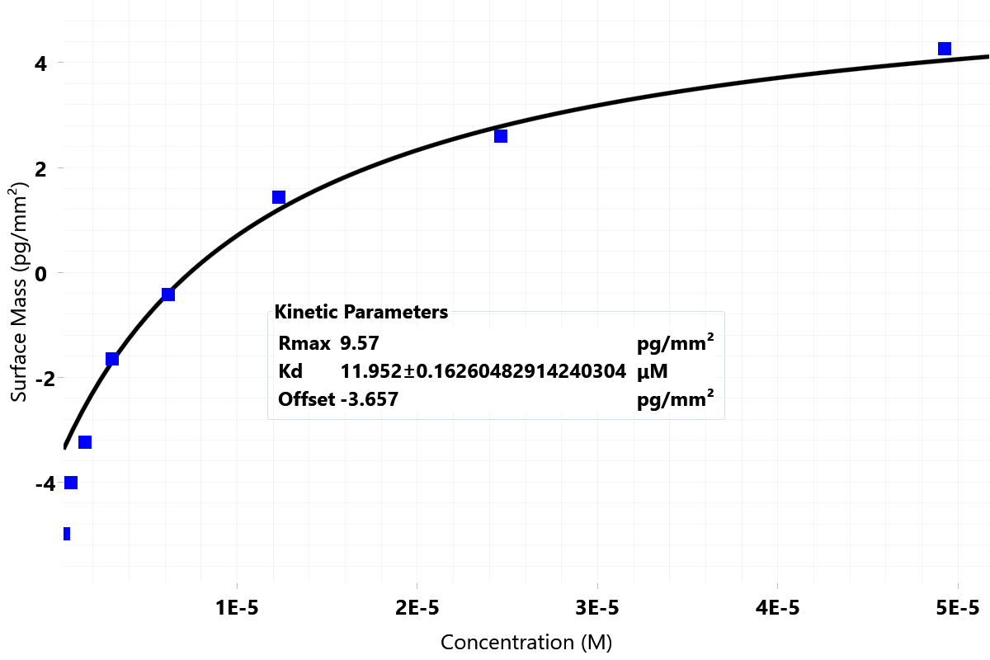
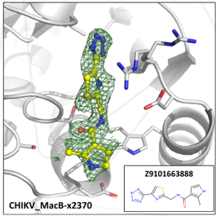
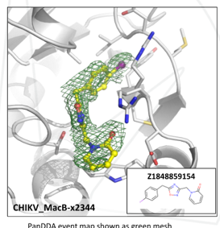
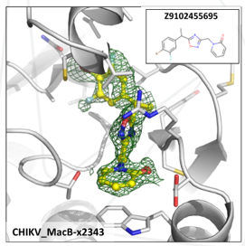
Pure catalogue compounds/ Analogues design
Okay density, binding observed in only one chain, different binding pose to fragment
Clear density, binding observed in only one chain
Clear density, binding observed in only one chain involving loop movement

Slide 3
Synthesis of expansion for SAR (reactants already ordered)
Top rated compound
c2370a - Z9101663888
RA-0188454-02
Planned SAR expansion
Purchased reactants

Slide 4
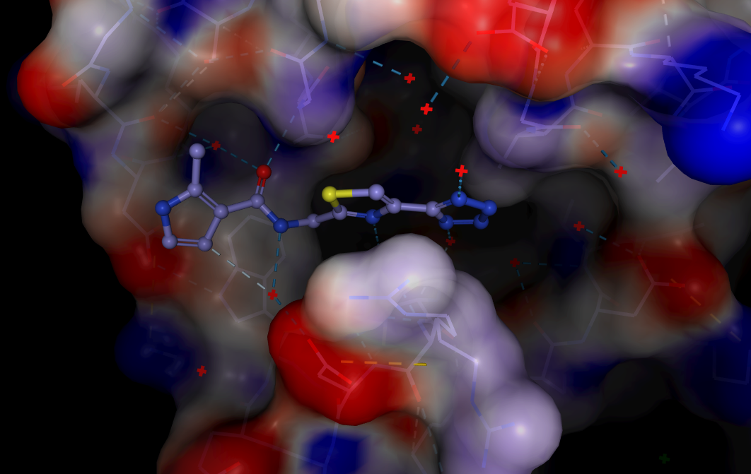
The original merged catalogue compound

Slide 5
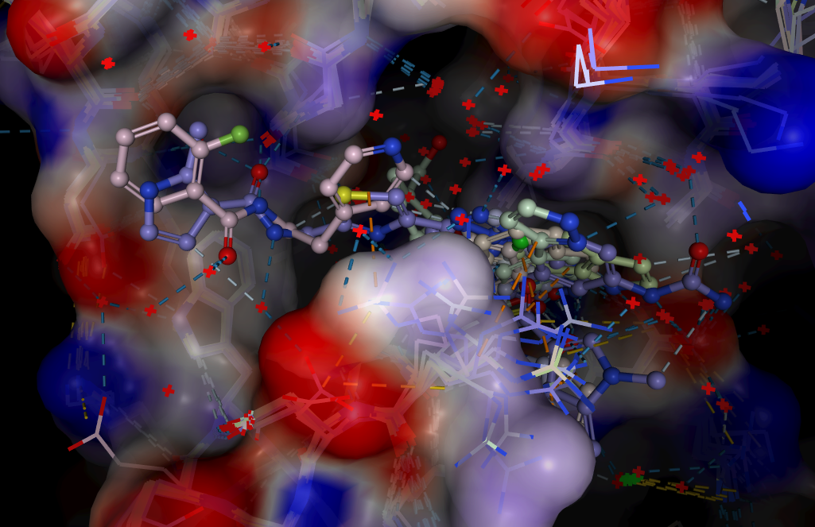
The original merged catalogue compound with the nearby fragments

Slide 6
Synthesis beyond currently ordered reagents

Slide 7
Synthesis of expansion for SAR (reactants already ordered)
Top rated compound
c2370a - Z9101663888
RA-0188454-02
Ordered reactants for the 1st expansion

Slide 8
Synthesis of expansion for SAR (reactants already ordered)
2nd rated compound
c2344a - Z1848859154
Purchased reactants
RA-0188499-02
Planned expansion
Preparation of 5-hydroxypyrimidine-4-carboxamide compounds for promoting erythropoietin (EPO) production

Slide 9
Synthesis of expansion for SAR (reactants already ordered)
3rd rated compound
RA-0188476-02
c2343a - Z9102455695
Planned expansion
Ordered reactants

Slide 10
